Slide 1


Setting behaviour of alkaline activated facing concrete for paving slabs
T. Schade, A. Wetzel, B. Middendorf
University of Kassel, Germany
Faculty of Civil and Environmental Engineering
Institute for Constructive Engineering
Dpt. of Structural Materials and Construction Chemistry
schade@uni-kassel.de
Notes:
.

Slide 2
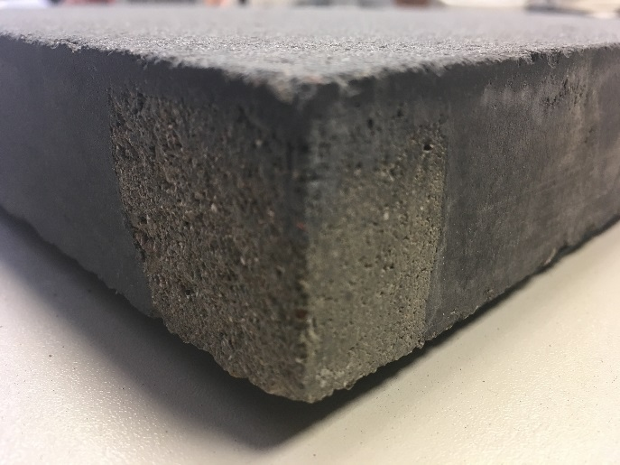

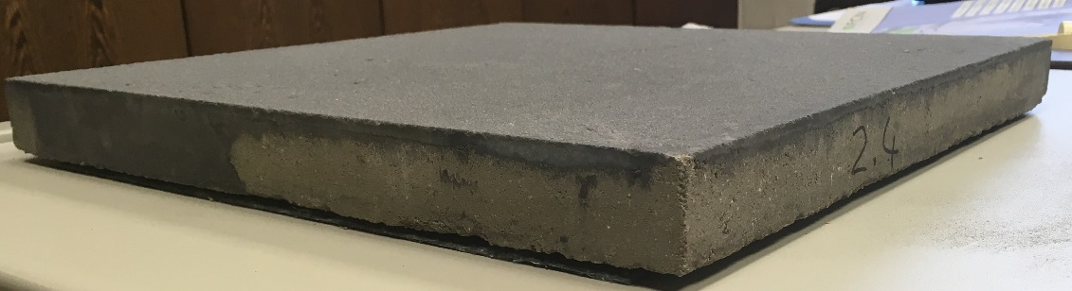
Outline
Motivation
Alkali-Activated-Materials (AAM)
Two-layered concrete paving slab process
Requirements
Presentation of methods and results

Slide 3
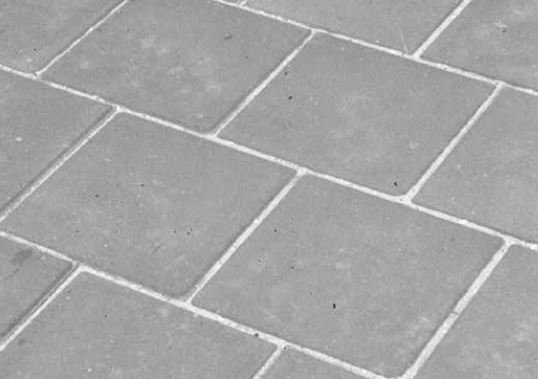
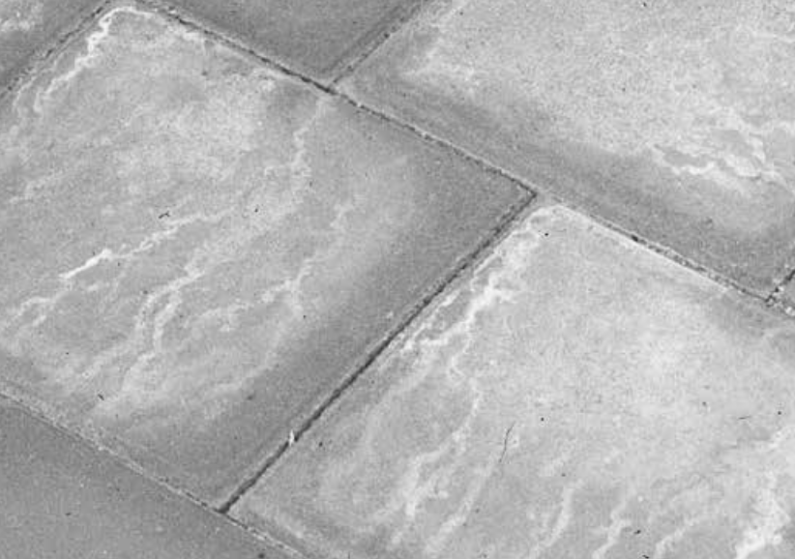
Motivation
white colorations due to efflorescence on the surface
increasing demand for paving slabs with dirt-resistant surfaces
previous actions (eg hydrophobing and impregnation) are not permanent
efflorescence after one week
efflorescence after two month
reference: Zement-Merkblatt Betontechnik B 27

Slide 4
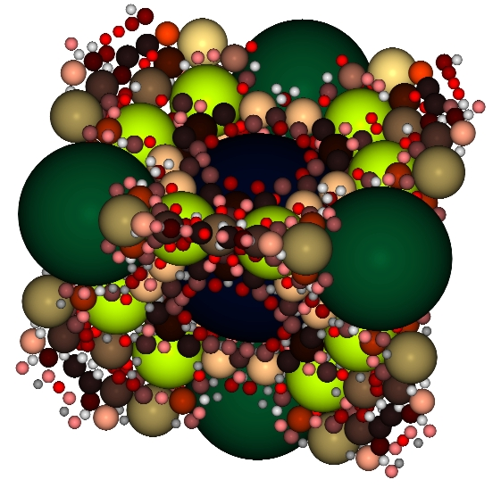
Approaches
packing density optimised concrete
first project with UHPC and CO₂-reactor
Wetzel, A., Piotrowski, S., Schade, T., Middendorf, B., 2017. Packing-density optimised face concretes for durable paving slabs [Packungsdichteoptimierte Vorsatzbetone für dauerhafte Terrassenplatten]. CPI – Concrete Plant International 2017, 74–80.
use of alternative binders with a less Ca/Si-ratio
  CO₂-footprint
  durability

Slide 5
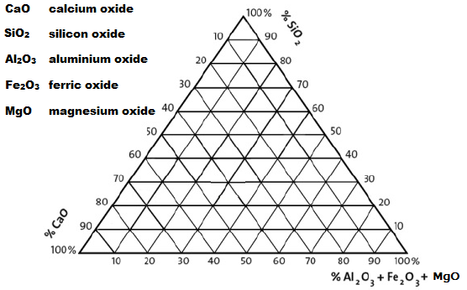
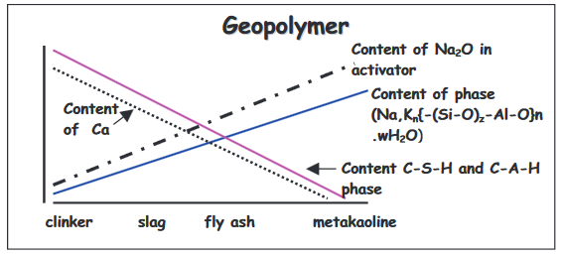
Alkali-Activated-Materials (AAM)
OPC face concrete
  clinker
AAM face concrete
  ground-granulated blast-furnace slag (GGBFS)
Škvára, F.: Alkali activated material - Geopolymer, Proc. International Conference
Alkali Activated Materials (Prague, 2007), pp. 661-676.

Slide 6
Basic mixture
cost-effective product
use of small percentage of silica-fume
use of sodium hydroxide and sodium water glass
GGBFS | 781 kg/m³ | water | 323 kg/m³
silica-fume | 80 kg/m³ | NaOH | 142 kg/m³
quartz powder | 154 kg/m³ | Na₂SiO₃ (SiO₂:Na₂O=3.4) | 303 kg/m³
quartz sand | 963 kg/m³ | NaOH/Na₂SiO₃ | 1.5
NaOH NaOH (with solid content)
Na₂SiO₃ Na₂SiO₃(with solid content)
40%
/ water content [%]
water
60%
/ water content [%]
→ w/b–value 0.375

Slide 7
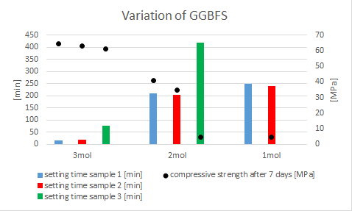
Basic mixture
characterisation of different GGBFSs with same specific surface (4000 cm²/g)

Slide 8
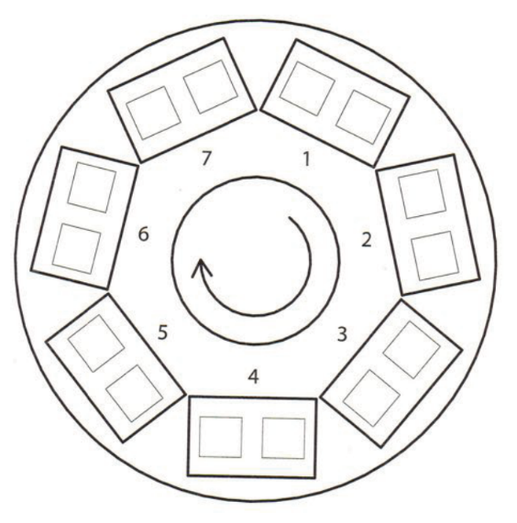
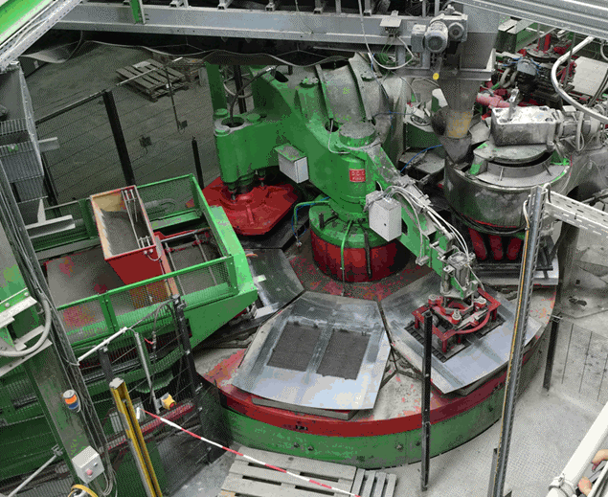
Two-layered concrete paving slab process
reference: Helmut Kuch / Jörg-Henry Schwabe / Ulrich Palzer, Herstellung von Betonwaren und Betonfertigteilen, Verfahren und Ausrüstung
preparing of the form
pouring of face concrete
vibration of face concrete
pouring of core concrete
pre press
main press
demoulding
extrusion punch
core concrete
H₂O
face concrete

Slide 9
Requirements and implementation problems
Extension of the cleaning-period of the mixture
Sufficient Flowability
Compressive Strength
Safety at work

Slide 10

Preliminary studies in laboratory scale
requirements:
begin of setting progress > 90 minutes
compressive strength ≥ 40 MPa
flow consistency by means of „Hägermanntisch“ around 15 cm

Slide 11
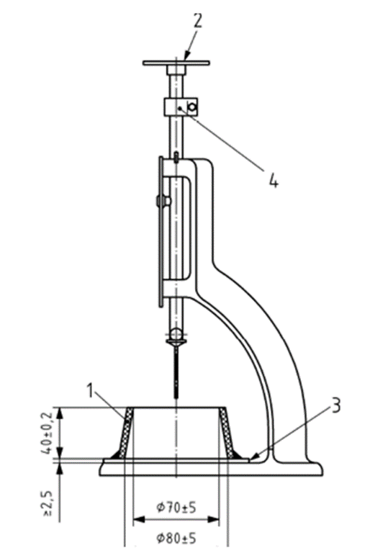
Setting process

Slide 12

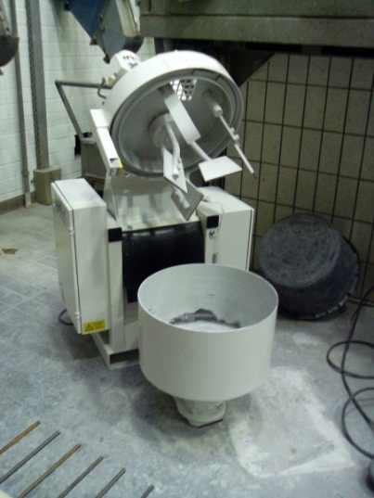
Effects of mixing duration and scaling-up
mixer/mixing duration | 7 days-strength (NaOH = 2 mol/l) | 7 days-strength (NaOH = 2.5 mol/l)
1l-Eirich / 15 minutes | 42 MPa | 63 MPa
30l-Zyklos / 10 minutes | 24 MPa | 40 MPa

Slide 13
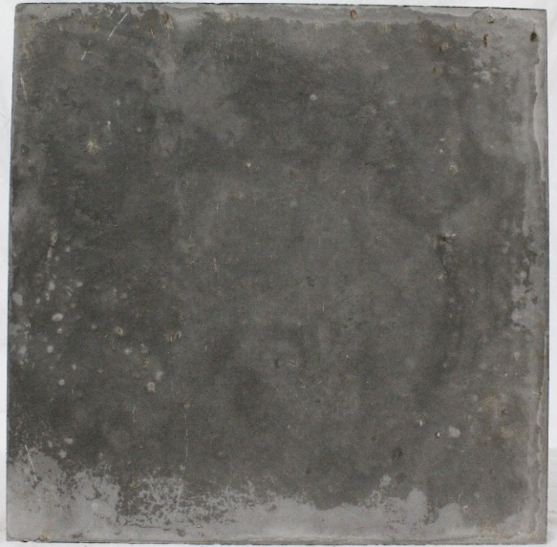
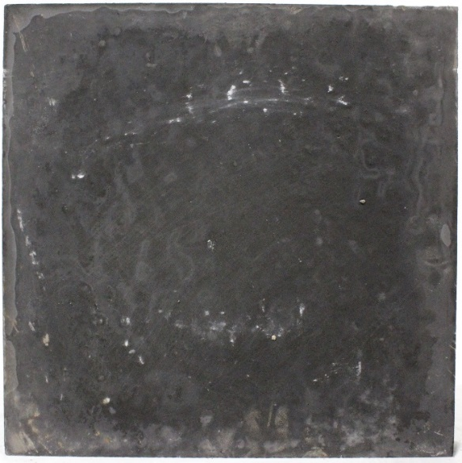
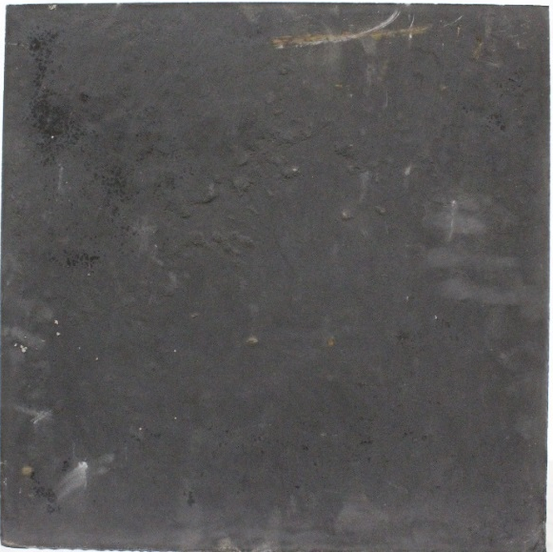
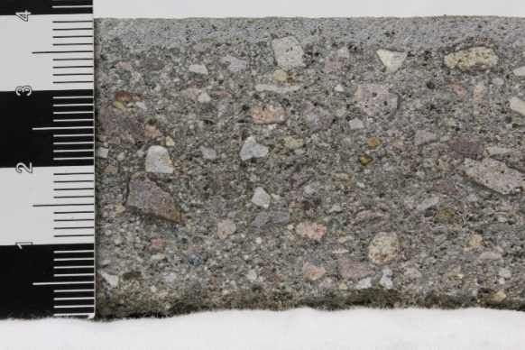
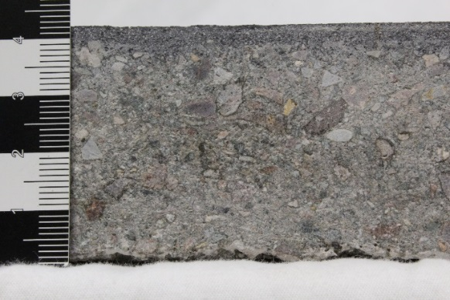
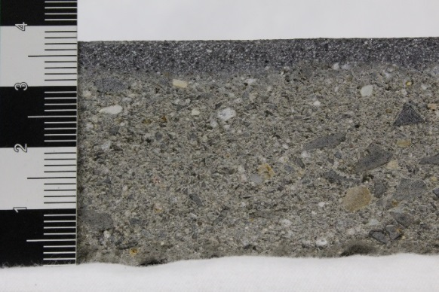
Results - prototypes
a
b
c
AAM-face concrete without pigments with OPC-core concrete
AAM-face concrete with pigments with OPC-core concrete
AAM-face concrete with pigments with AAM-core concrete

Slide 14
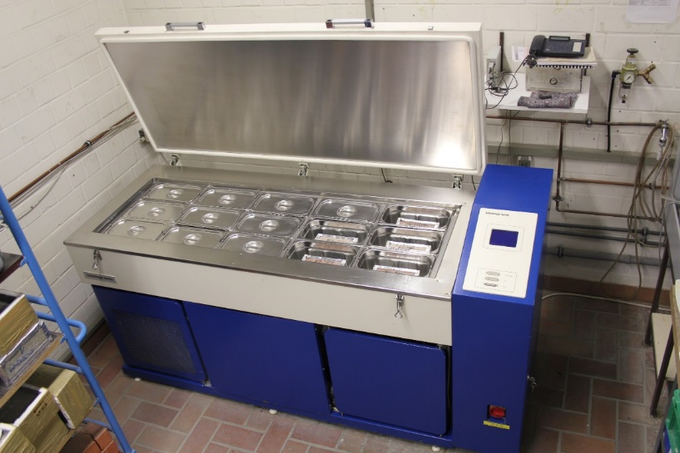
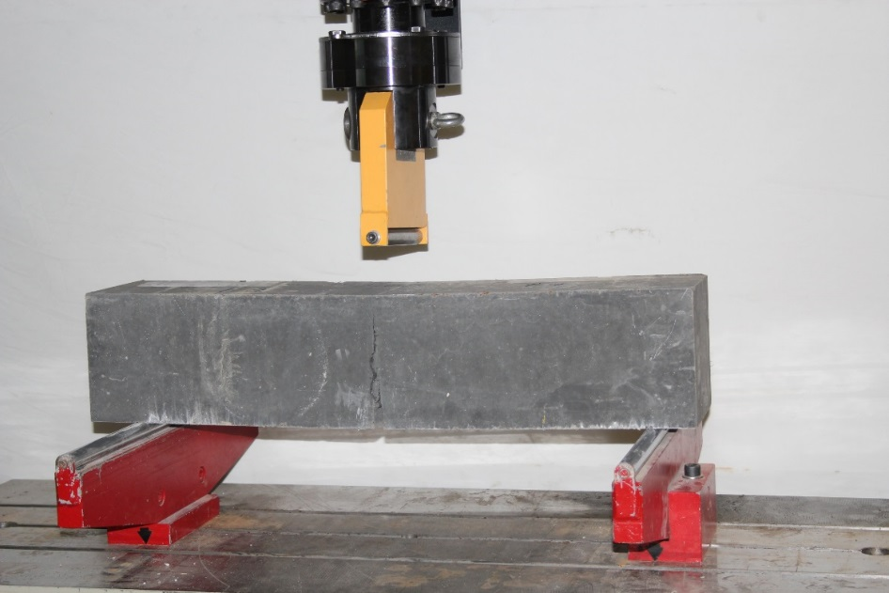
Results according to DIN EN 1339
CDF-test
bending strength
abrasion resistance

Slide 15
Results according to DIN EN 1339
 | CDF | abrasion resistance | flexural strength
 | [g/m²] | [cm³/50cm²] | [MPa]
reference concrete | 233 | 24.5 | 5.0
UHPC-face concrete | 40 | 10
AAM-face concrete without pigments with OPC-core concrete | 574 | 10.5 | 5.2
AAM-face concrete with pigments with OPC-core concrete | 641 | 12.3 | 5.4
AAM-face concrete without pigments with AAM-core concrete |  | 11.3 | 4.0
limits (DIN)* | ≤ 1000 | ≤ 20.0 | ≥ 4.0
*limits due to the highest category in the German Industrie Standard (DIN)

Slide 16
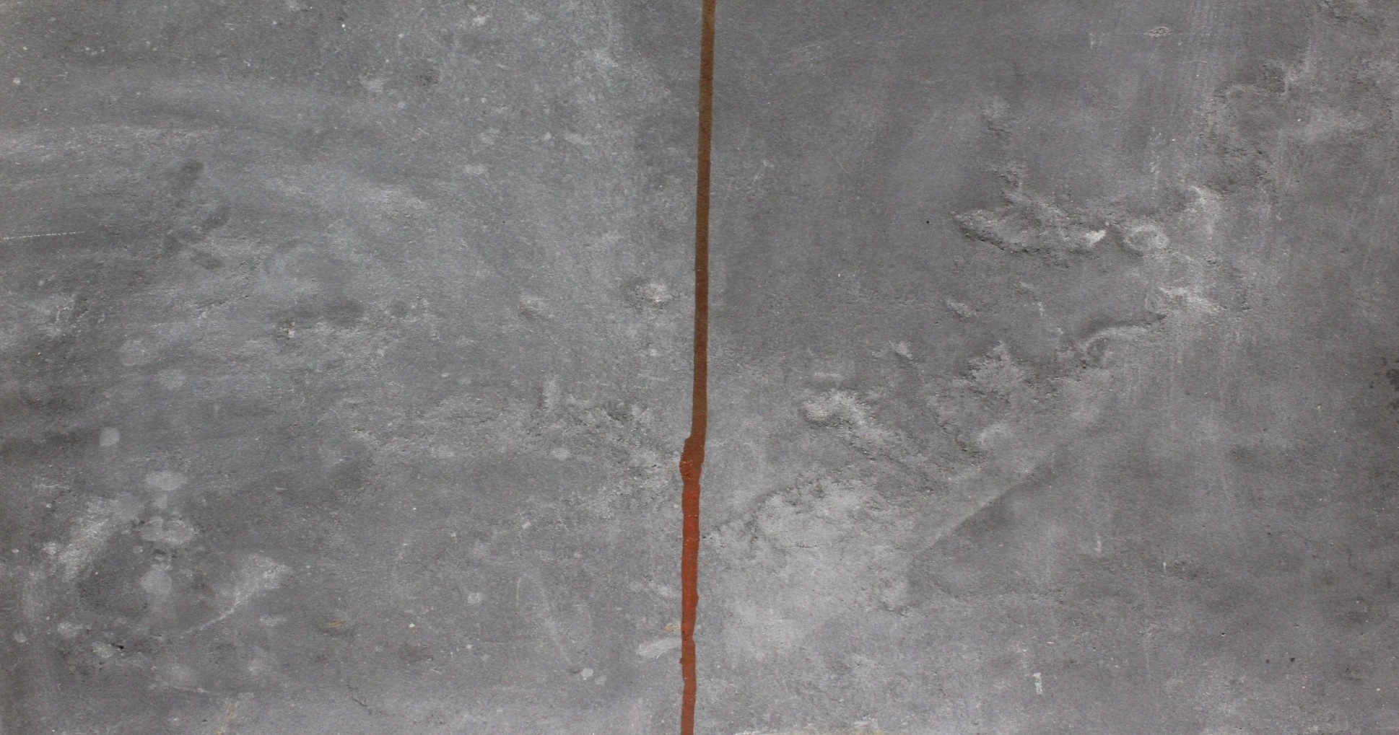
Results
asthetical requirements
dripping test → addition of deionised water (0.5 g)
Prepared area
Unprepared area

Slide 17
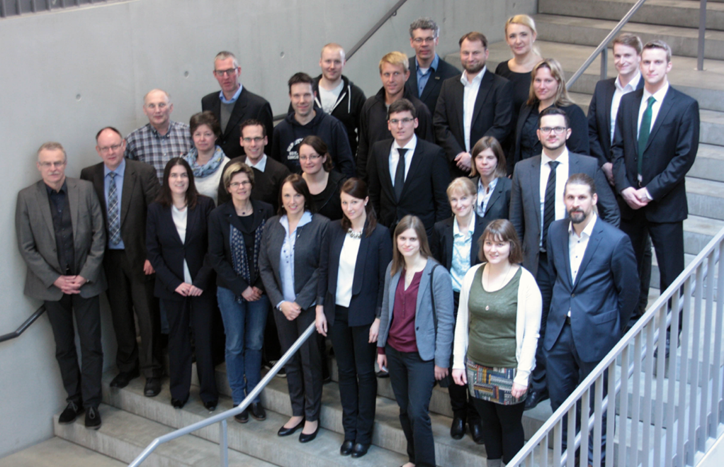



Thanks for your interest!
5th International Symposium on
Ultra-High Performance Concrete and
High Performance Construction Materials
www.hipermat.com
Submit abstracts until 30th of April 2019
11th-13th March 2020
in Kassel (Germany)
Special thanks for the support!
schade@uni-kassel.de

